Slide 1
자료구조 및 알고리즘 - Hashing
Taehyoun Kim
Dept. of Mechanical & Information Engineering,
University of Seoul

Slide 2
Contents
General Idea
Hash Function
Separate Chaining
Open Addressing
Linear Probing
Quadratic Probing
Double Hashing
Rehashing
Extendible Hashing

Slide 3
Hashing
Tree-based data structures for dictionary
O(lg n) access time
Can we do better than this?
If we are willing to consider an expected case rather than the worst case, there is a O(1) method with high probability ➔Hashing
Certain operations such as PrintAll, FindMin, FindMax cannot be efficiently performed.

Slide 4
Hashing
Hashing is a method that performs all dictionary operations (find, insert, delete) in O(1).
Since hashing is so good, it is the method of choice when just these operations (find, insert, delete, …) are performed
Trees are preferred when
(1) storing data on second storage (B-tree), or
(2) relative ordering of elements is important (find elements in
some range)
Typical application areas of Hashing
Symbol Table of variables in compilers
Virtual-to-Physical memory translation (page directory)

Slide 5
Components of Hashing
Hash Table
containing m entries, possibly keys (an array of fixed size m).
A key is typically a character string.
Hash Function h(k) : arithmetic function
that transforms each key k to into an address (index) of the hash table in the range [0..m-1] (h: U → {0, 1, …, m-1})
A hash function is usually the composition of two maps:
Hash code map: key → integer
Compression map: integer → [0,…, m-1]
Different keys might be mapped (“hashed”) to the same location and this is called Collision.

Slide 6
Hash Function
A good hash function
should be simple (fast) to compute
should produce less collisions - different keys to different integers (ideally, random function)
Don’t forget that equal keys should be mapped to equal positions in the hash table.
But, this is actually impossible.
So, at least, we seek a hash function that distribute the keys evenly over hash table. (We still need a method for resolving the collisions !!!)
Two important topics in Hashing
How to select a good Hash Function
How to resolve collision
Notes:
예시) 우편번호 – 시군구 동 주소 매핑 레코드
key로 우편번호 앞자리를 잡을 때 동대문구 130 임. 743으로 하면 100 개 정도. 130으로 하면 271개. 어떤 게 더 나은가 ?
개인정보를 저장할 때 생년월일에서 생년으로 잡는 게 나을까 ? 생년으로 잡으면 60~80만명. 월일로 잡으면 평균적으로 10만명대.
전화번호부 (전화번호 – 이름 – 주소)
지역번호로 하는 게 나을까 ? 마지막 뒷자리로 하는 게 나을까 ?

Slide 7
Hash Function: Hash Code Maps
Integer cast
For numeric types with 32 bits or less, we can reinterpret the bits of the number as an integer
Component sum
For numeric types with mode than 32 bits, we can add the 32-bit components
Bad for strings
lots of similar length strings collide: dad vs. add, dog vs. god
Polynomial accumulation
For strings of a natural language, combine the character values by viewing them as the coefficients of a polynomial
“acb” => 26 * (26 * 1 + 3) + 2
number gets easily bigger than an int
In many cases, keys are given as a form of character string.

Slide 8
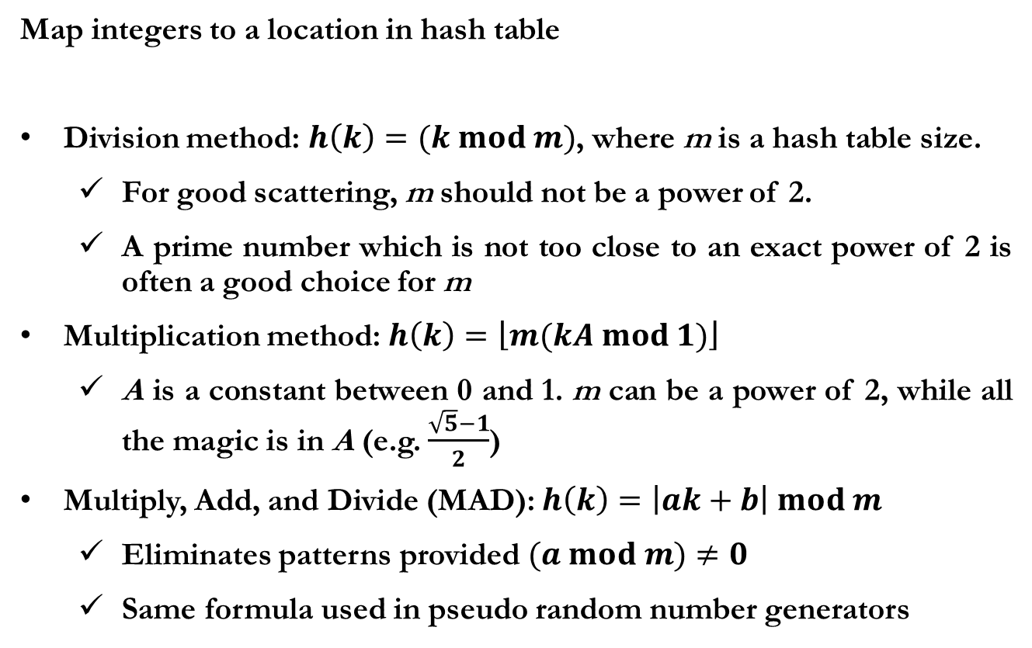
Hash Function: Compression Maps
Map integers to a location in hash table
Division method: $h\left(k\right)=(k mod m)$, where m is a hash table size.
For good scattering, m should not be a power of 2.
A prime number which is not too close to an exact power of 2 is often a good choice for m
Multiplication method: $h\left(k\right)=\left\lfloor m(kA mod 1)\right\rfloor$
A is a constant between 0 and 1. m can be a power of 2, while all the magic is in A (e.g. $\frac{\sqrt{5}−1}{2}$)
Multiply, Add, and Divide (MAD): $h\left(k\right)=\left|ak+b\right| mod m$
Eliminates patterns provided $(a mod m)≠0$
Same formula used in pseudo random number generators

Slide 9
Collision Resolution
Two approaches for collision resolution
Separate chaining (Closed addressing)
Put keys that collide in a linked-list associated with index
Open addressing
When a key collides, find next empty slot and put it there

Slide 10

Open Hashing (Separate Chaining)
Each of m locations of the hash table is a simple head pointer to a linked list; Table[i] holds all keys hashed to the location i.
All records are stored outside the hash table.
Use an array of m < n (m ≈ n/10)
0
1
2
3
4
5
6
7
8
9
20
10
$$h\left(k\right)=(k mod 10)$$
1
Insertion Sequence
Insert(10)
Insert(56)
Insert(44)
Insert(1)
Insert(20)
Insert(36)
44
36
56
Notes:
Hash function으로는 modulo 연산이 쓰임
M이 너무 크면 empty slot이 많아짐. M이 너무 작으면 chain이 길어짐

Slide 11
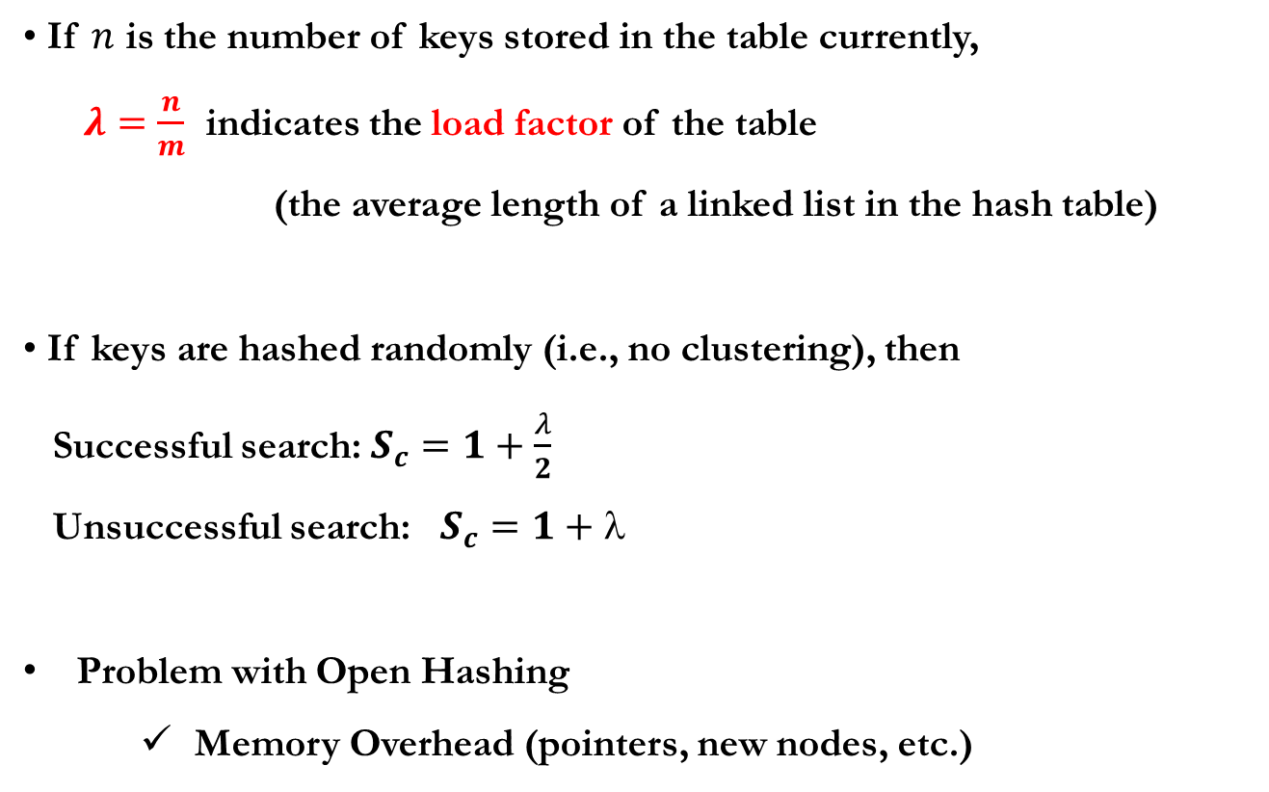
Running Time of Open Hashing
If $n$ is the number of keys stored in the table currently,
$λ=\frac{n}{m}$ indicates the load factor of the table
(the average length of a linked list in the hash table)
If keys are hashed randomly (i.e., no clustering), then
Successful search: $S_{c}=1+\frac{λ}{2}$
Unsuccessful search: $S_{c}=1+$
Problem with Open Hashing
Memory Overhead (pointers, new nodes, etc.)
If n=O(m), then 𝜆 = n/m = O(m)/m = O(1),
hence searching takes constant time on average.
Deletion has the same property.
Unsuccessful search: no element found in the table with the given key
Successful search: the search successfully finds an element with the given key
Notes:
Successful search: 찾을 수 있을 때 (1 은 hash function 동작 시간)
Unsuccessful search: 못 찾을 때
Load factor를 줄이는 것이 관건임.

Slide 12
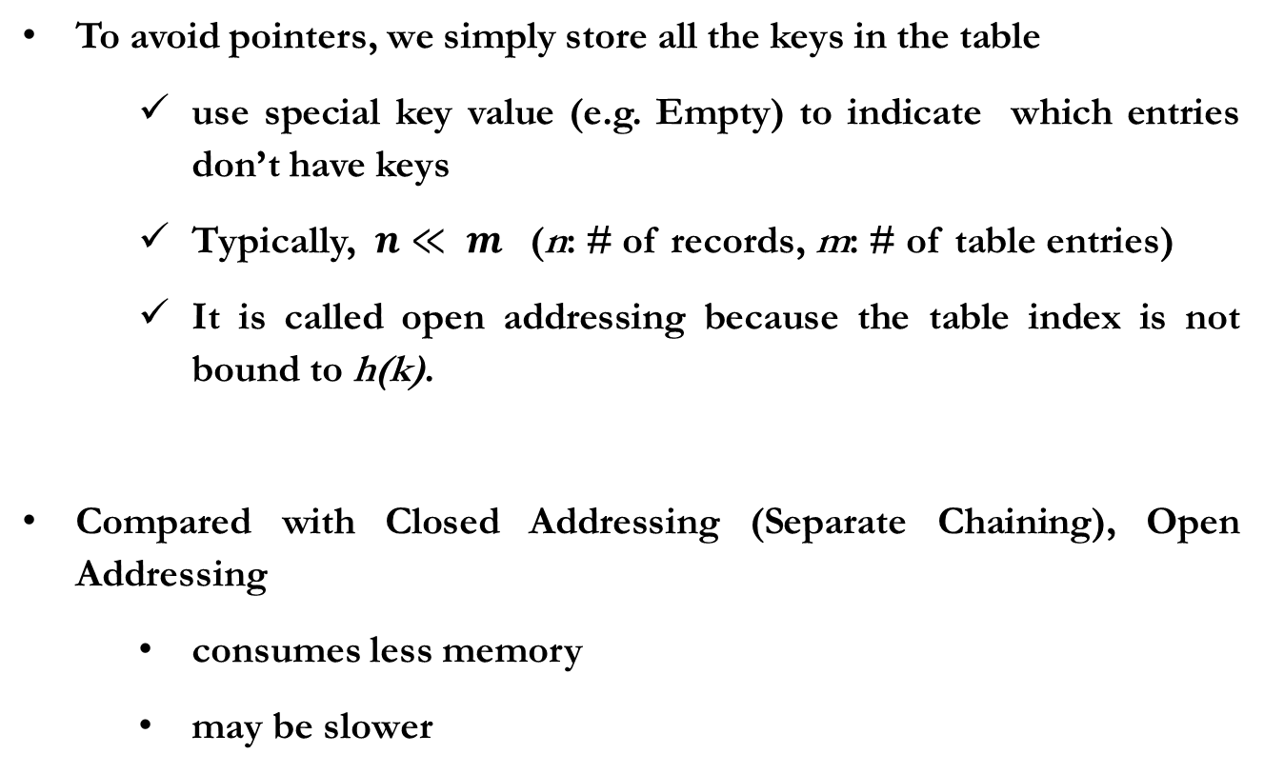
Closed Hashing (Open Addressing)
To avoid pointers, we simply store all the keys in the table
use special key value (e.g. Empty) to indicate which entries don’t have keys
Typically, $n≪ m$ (n: # of records, m: # of table entries)
It is called open addressing because the table index is not bound to h(k).
Compared with Closed Addressing (Separate Chaining), Open Addressing
consumes less memory
may be slower

Slide 13
Closed Hashing (Open Addressing)
We need some way of finding out which entry to go next when a collision occurs;
Try the location (h(k) + f(1)) mod m, (h(k) + f(2)) mod m ... until finding an open location.
This sequence is called a probe sequence, and ideally it should be capable of searching the entire list.
With Open Addressing, the number of distinct probe sequences is important.
How to choose f ?
Linear Probing
Quadratic Probing
Double Hashing

Slide 14
Linear Probing
Try sequential locations: f(i) = i
As the table becomes full, the performance gets very bad.
insert(50)
insert(42)
insert(92)
insert(31)
0
1
2
3
4
5
6
7
8
9
0
1
2
3
4
5
6
7
8
9
0
1
2
3
4
5
6
7
8
9
0
1
2
3
4
5
6
7
8
9
10
50
42
92
31
// Insert with Linear Probing
LinearProbingInsert(k)
if (Table is full)
error
probe = h(k)
while (table[probe] occupied)
probe = (probe+1) mod m
table[probe] = k
10
50
10
50
42
10
50
42
92

Slide 15
Problem with LP: Clustering
Primary Clustering
Many keys with the same hash value (due to poor choice for hash function) can build up long runs of occupied slots.
Other keys with the adjacent hash values to the cluster may be greatly affected.
The problem with clustering is that even if the table is relatively empty, any key that hashed into the cluster will require several attempts to resolve the collision, and then it will add to the cluster.

Slide 16
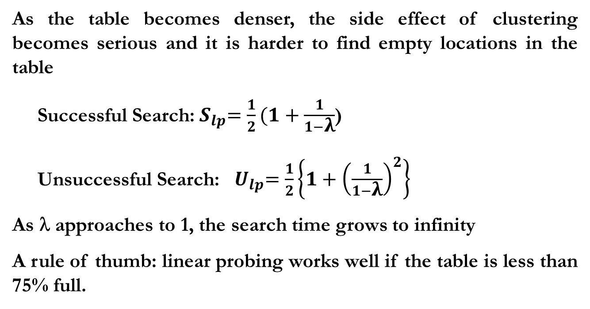
Problem with LP: Clustering
As the table becomes denser, the side effect of clustering becomes serious and it is harder to find empty locations in the table
Successful Search:${ S}_{lp}=\frac{1}{2}(1+\frac{1}{1−\text{λ}}$)
Unsuccessful Search: ${ U}_{lp}=\frac{1}{2}\left\{1+{\left(\frac{1}{1−\text{λ}}\right)}^{2}\right\}$
As λ approaches to 1, the search time grows to infinity
A rule of thumb: linear probing works well if the table is less than 75% full.

Slide 17
Number of Probes vs. Load Factor
15.0
12.0
9.0
6.0
3.0
0.0
U, I
U, I
S
S
.10 .15 .20 .25 .30 .35 .40 .45 .50 .55 .60 .65 .70 .75 .80 .85 .90 .95
linear probing
random strategy
U: unsuccessful search
I : insertion
S : successful search
Notes:
Random strategy가 best collision resolution 방법이라고 가정.
즉, probing을 하기 위해 사용하는 index가 empty location 전체에 대해 uniformly distributed random function 이라고 가정

Slide 18
Deletions in Closed Hashing
Use special value Del to distinguish deleted and empty locations
If we see Del during probing
find( ): keep searching until empty
insert( ): reuse the Del location for placing a new key
delete(42), find(31)
0
1
2
3
4
5
6
7
10
50
92
31
0
1
2
3
4
5
6
7
10
50
Del
92
31

Slide 19
Quadratic Probing
To avoid primary clustering, use non-linear probing that scatters subsequent probes around
If the index h(x) is full, consider f(i) = i²
(h(x) + 1) mod m, (h(x) + 4) mod m, (h(x) + 9) mod m
Experience shows that this succeeds in breaking down the primary clusters arising from linear probing
Example: m = 10, h(k) = k mod 10, insert 89, 18, 49, 58, 69

Slide 20
Quadratic Probing
One tricky question:
In linear probing, it is guaranteed that as long as there is one free location(slot) in the table, we will eventually find it without repeating any probe locations
Is this also true for quadratic probing?
Fortunately, quadratic probing does a good job of visiting different locations with proper combination of table size and hash function.
It can be formally proved that if m is prime, the first m/2 locations that quadratic probing visits will be distinct.

Slide 21
Quadratic Probing
Theorem. If quadratic probing is used and the table size m is prime, then an element can always be inserted if the table is at least half empty.
Proof: Prove the first m/2 locations that quadratic probing visits will be distinct. Let us use contradiction.
For
This means that (i – j)•(i + j) is a multiple of m. Since m is prime, either (i – j) or (i + j) must be a multiple of m. Since i ≠ j, and
, neither (i – j) nor (i + j) can be a multiple of m.

Slide 22
Quadratic Probing
Quadratic probing eliminates primary clustering but it introduces another problem, called Secondary Clustering.
In QP, at most half of the hash table can be used as alternative locations to resolve collisions. This means that once the table is more than half full, it's difficult to find an empty slot.
This new problem is known as Secondary Clustering because elements that hash to the same hash key will always probe the same alternative cells.

Slide 23
Double Hashing
Use other hash function for random probing
For a hash function h₂(k), f(i) = i × h₂(k)
h₂(x) should not be zero.
h₂(k) = (R – k) mod R, where R is a prime number which is smaller than m is a popular choice
// Insert with Double Hashing
DoubleHashingInsert(k)
if (Table is full)
error
probe = h₁(k)
offset = h₂(k)
while (table[probe] occupied)
probe = (probe+offset) mod m
table[probe] = k
Notes:
table size m이 prime이 아니면 문제가 되는 이유? h2 값과 m이 서로 소가 아닌 경우, probe sequence가 몇 개로 한정.

Slide 24
Double Hashing
Example: m = 10, h₂(k) = 7 – (k mod 7),
insert 89, 18, 49, 58, 69
now insert 60? insert 23?
Simulation shows that double hashing does a good job, almost the same as for a random collision resolution strategy.
In practice, quadratic probing is simpler and faster than double hashing because QP does not require the second hash function.

Slide 25
Rehashing
If the table becomes full so that performance start degrading (e.g., the load factor is 0.8 or 0.9)
We reallocate a new table that is twice larger
Then, we create a new hash function
Finally, we go through the old table and hash all the keys in the new table, then delete old table.

Slide 26
Rehashing
Rehashing takes O(n) time.
But it happens once after N inserts. Thus, it essentially adds a constant cost to each insertion.
Example: m = 7, h(k) = k mod 7, linear probing
rehash when the load factor is over 0.7, with m_{new} the smallest prime as large as 2m and h_{new}(k) = k mod m_{new}
insert 13, 15, 6, 24, 23

Slide 27
Hashing on Disks
Can we still apply hashing if the hash table is too large to fit in main memory?
Locality is important for large data structures
(Disk access is costly, but memory access is cheap.)
The problem with hashing with most efficient probing (like double hashing or quadratic probing) is its lack of locality
(e.g., if you probe 6 times, you might access the disk 6 times!)
We need a method to reduce the number of disk accesses

Slide 28
Extensible Hashing
The hash table is broken into a number of smaller hash tables, each is called a bucket.
The maximum size of each bucket is the size of a disk page.
To find which bucket to search for, we store a data structure called directory in main memory, and each entry in the directory holds a disk address of the corresponding bucket.
Each bucket can hold as many records that can be fit in one page, and we will try to keep each bucket at least half full.
Let m be the size of each bucket which is dependent on the size of disk and records, then it is important to make m fairly large (e.g., at least 4). If records are too large, just store pointers to each record.

Slide 29
Directory in Extensible Hashing
The size of the Directory D is always 2^{k}
As the table grows, the power k increases
For example, the size is 2^{k}
To decide which bucket to store a key x, compute h(x)
We extract the first k bits of h(x) that is q, and store x in the bucket pointed by D[q] (q is in the range of 0 to 2^{k} – 1)

Slide 30
An example when k = 2 and m = 4
00 | 01 | 10 | 11
000100
001000
001010
001011
010100
011000
100000
101000
101100
101110
111000
111001

Slide 31
Insertion of 100100
000 | 001 | 010 | 011 | 100 | 101 | 110 | 111
000100
001000
001010
001011
010100
011000
100000
100100
101000
101100
101110
111000
111001

Slide 32
Insertion of 000000
000 | 001 | 010 | 011 | 100 | 101 | 110 | 111
000000
000100
001000
001010
001011
010100
011000
100000
100100
101000
101100
101110
111000
111001

Slide 33
Insertion
If there is a room in the bucket, insert. Otherwise, split the bucket.
One additional bit for our directory
Split the bucket that overflowed.
We don’t have to split others
This scheme becomes bad if all keys go to the same bucket (Since we extract bits after hashing, ununiform distribution of initial keys do not mean ununiform distribution of hash results.)

